Slide 1
PRESENTED BY:- AJIT MADAME PROJECT NAME :- CUSTOMER RETENTION

Slide 2
Agenda
Introduction
Problem Statement
Problem Understanding
What is Customer Retention?
Importance and Benefits of Customer Retention
EDA
Visualization
Assumptions
Conclusion

Slide 3
INTRODUCTION E-commerce is a term for any type of business that involves the exchange of information across electronic networks. It involves all aspects of an organization’s interaction or commercial transaction with suppliers, clients, stakeholders, and customers, etc. The greatest advantage is its huge reach across the global market and being able to conduct business 24x7x365 days by selling various kinds of goods. Presently, the number of people having access to the internet platform has been increased to a greater extent and this has led e-commerce business to grow rapidly. Since the e-commerce platform has enabled the customers to directly interact with sellers, it has led to a reduction in the supply chain process and accordingly customers also get to buy at a lower rate. It provides various choices for customers to choose among different sellers according to their preference for a product and budget ascertained. Since the users of e-commerce platform are increasing rapidly it urges every seller to pull new customers and also to retain loyal customers. Retaining on loyal customers creates a regular income, the ultimate goal of every seller is to transform occasional customers into loyal a one. Thus, it has urged sellers to create various retention strategies to increase profitability and gain market share by retaining customers.

Slide 4
PROBLEM STATEMENT Customer satisfaction has emerged as one of the most important factors that guarantee the success of online store; it has been posited as a key stimulant of purchase, repurchase intentions and customer loyalty. A comprehensive review of the literature, theories and models have been carried out to propose the models for customer activation and customer retention. Five major factors that contributed to the success of an e-commerce store have been identified as: service quality, system quality, information quality, trust and net benefit. The research furthermore investigated the factors that influence the online customers repeat purchase intention. The combination of both utilitarian value and hedonistic values are needed to affect the repeat purchase intention (loyalty) positively. The data is collected from the Indian online shoppers. Results indicate the e-retail success factors, which are very much critical for customer satisfaction. Since the dataset do not contains target/dependent variable, hence we can consider this as unsupervised learning

Slide 5
PROBLEM UNDERSTANDING The problem statement examined how customers form expectations on technology based self-service quality and suggested five main attributes of ecommerce store quality, that are service quality, system quality, information quality, trust and net benefit. Many businesses focus on customer loyalty programs to remain competitive in today’s marketplaces and explore innovative ways to keep their existing customers engaged. Customer retention is a simple concept. Yet, it often requires effort from every department to improve the customer experience and build lasting trust. So, what is customer retention and why it is so important. Let’s know about it by analysing the problem.

Slide 6
WHAT IS THE CUSTOMER RETENTION? Customer retention refers to a company's ability to turn customers into repeat buyers and prevent them from switching to a competitor. It indicates whether your product and the quality of your service please your existing customers. Customer retention refers to the activities and actions companies and organizations take to reduce the number of customer defections. The goal of customers retention programs is to help companies retain as many customers as possible, often through customer loyalty and brand loyalty initiatives.

Slide 7
WHY IS CUSTOMERS RETENTION IMPORTANT? Customer retention seems equally important for any eCommerce store irrespective of their survival. It measures the success rate of a store’s new customers and spread out ideas to satisfy their existing customers too. Retained customers would probably buy more often and would like to spend more than newer customers. They have learned the value of the product or service you offer and that will make them visit again. Connecting your customers emotionally will help in extending the lifetime of the customers in your eCommerce store. It is four times greater than without the personal touch. It empowers customers to share feedback with the company team. It helps you understand how loyal and satisfied your customers are, how strong your customer service is, and your product are really worth their money or not.

Slide 8
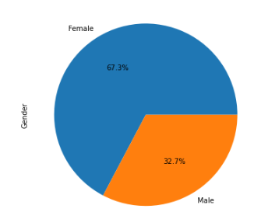
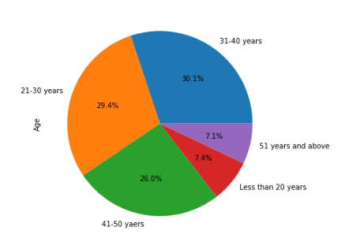
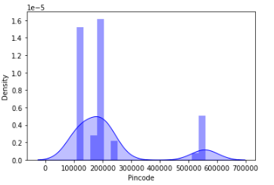
Exploratory Data Analysis (EDA) Steps: UNIVARIATE: - Observation:- We can see, pin code is not normally distributed. It seems to contain outliers. Data is positively skewed. - We can see, Female are in more number than male who doing shopping’s. There are 67.3% female are doing shopping online and 32.7% male doing shopping online. - 40-50 years of Age customers are doing more shopping than others. The Age group between 31 to 40 year, there are 30.1% customer also doing shopping. As we considered that, from 20 to 50 years of age, In this age group customer are highest.

Slide 9
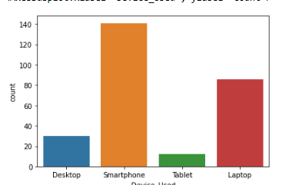
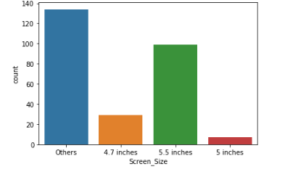
Most of the customers used Smartphone device to access the online shopping and followed by Laptop. Only few customers used Tablet to access the online shopping.
The count is high for others mobile screen size followed by 5.5 inches screen size and 5 inches screen size has least count. That means, the customers who have their mobile screen size other than mentioned inches shopped more online followed by 5.5 inches and the customers having mobile screen size 5 inches shopped very less.

Slide 10
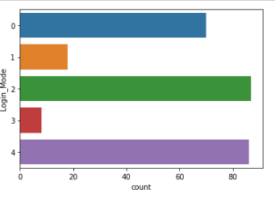
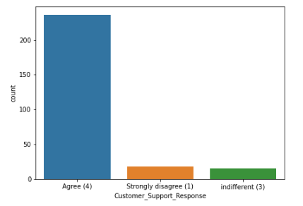
Observation:- # Most of the customers used Search Engine and Via application to reach the online retail store after their first visit and also some customers used Detect URL to reach the online store. Which means these customers have downloaded their most favorite application to reach the online stores easily. # The count is high for the customers who agreed the customer support response is good towards the customers in the online shopping website is very helpful. Customer grievance redressal mechanism is very helpful to make business profitable. If the online shopping companies ready to assist with customers queries then there will be benefit for both company and the customers.

Slide 11
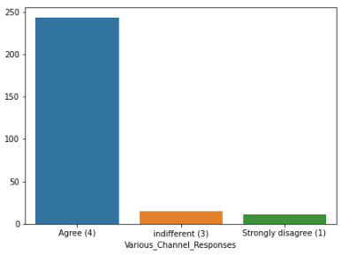
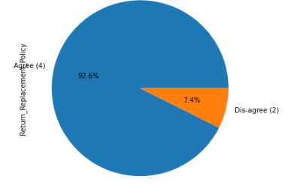
Observation:- # The count is high for the customers who agreed the customer support response is good towards the customers in the online shopping website is very helpful. Customer grievance redressal mechanism is very helpful to make business profitable. If the online shopping companies ready to assist with customers queries then there will be benefit for both company and the customers. # 92.3% of the customers strongly agree and 7.4% of the customers agree that the return and replacement policy help them making purchase decision. It is evident from the fact that the customers actually liking the products completely, they are just purchasing the products.

Slide 12
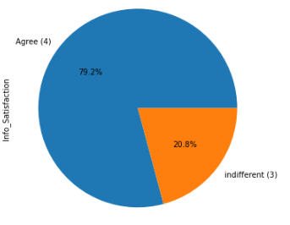
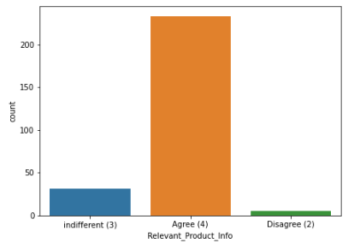
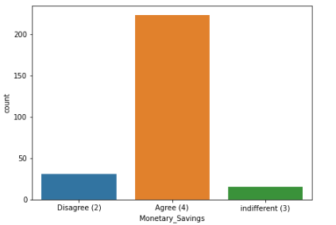
Observation:- => 79.2% of the customers agreed that displaying quality information on the website improves satisfaction of customers since they believe that displaying quality information have significant association with customer satisfaction. => Most of the customers would like to have provision of complete and relevant product information in the online shopping website. They are having good satisfaction with relevant product information. But very few customers are dis-agreed with this. They think that, relative information of product is not enough to buying the product. => Most of the customers agreed to receive monetary savings. The ecommerce company need to give the feel to customer for buying product because if the customer think that, if he buys the product from online the he would save some money than other way. This saving would automatically get converted into trust and brand equity for the seller. Due to this the online companies should offer the best deals. If the retailers give some discounted prices then the customers can make money savings.

Slide 13
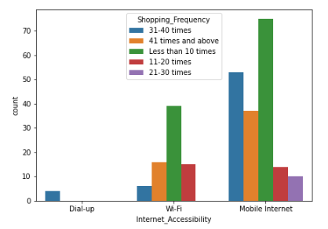
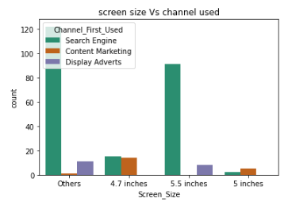
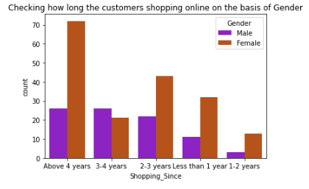
Bivariate Visualization: - Observation: - # Most of the female customers shopped online from more than 4 years and the count is also high for the females who shopped from 2-3 years. And only few male customers shop online more than 4 years. Which means the female customers are more enthusiastic to buy products from the online shopping websites # Most of the customers access the shopping websites more than 31-40 times in 1 year through Mobile Internet to shop the products also most of the customers who used mobile internet to access the online shopping website made online purchase less than 10 times in a year. # The customers having their mobile screen size 6 inches(others) have followed search engine channel. Also, the customers who have their screen size 5.5 inches also used search engine channel to access the online shopping store.

Slide 14
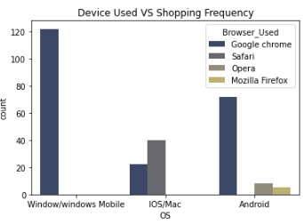
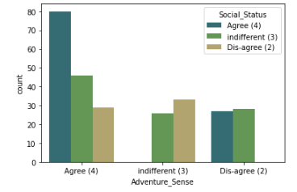
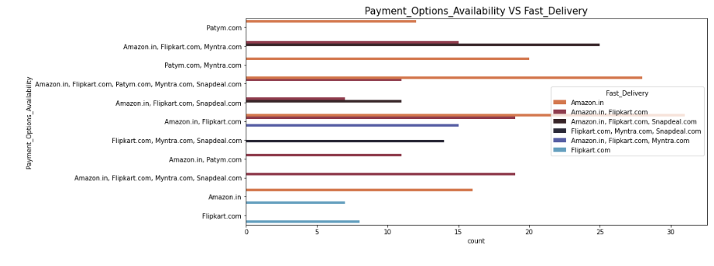
Observation:- # Many customers having windows operating system in their device ran Google chrome to access the ecommerce shopping websites and some of the customers having IOS/Mac operating system used Google chrome as well as Safari to reach the online shopping store. # Most of the customers agreed that shopping on the website gives the sense of adventure. They also believe that shopping on preferred e-tailer enhances the social status of the customers. Shopping online won't affect anyone's status and the customers agreed that shopping on preferred e-tailer enhances their social status. # Here amazon and flip kart have several payment options and amazon indeed has speedy order delivery compared to other websites. Having different types of payment methods will helps the customers to pay the easily using their choice of payment. The websites have speedy delivery methods, then the customers like to buy the products in those websites.

Slide 15
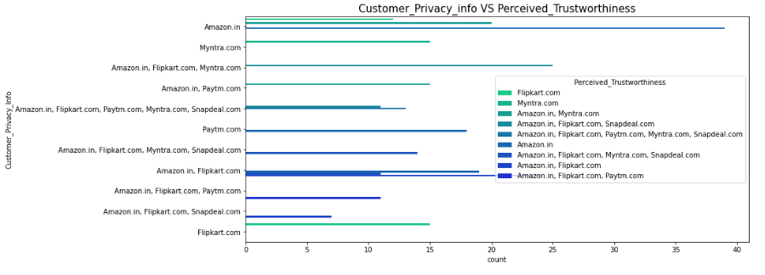
Observation:- Customers are always concerned whether the website would protect them against fraud after a transaction. So, website security and privacy are important to assess the service quality of online stores. The customers think that buying online means taking risk, in this case trust is more important thing for both merchant and customer. Most of the customers trusts amazon followed by flip kart in terms of keeping their privacy of data information secured. Myntra, Snapdeal and Paytm in terms of keeping their financial information secured. Most of the customers believed that Amazon has perceived trustworthiness compared to others. Apart from this, customers believed that flip kart and Myntra also have perceived trustworthiness.

Slide 16
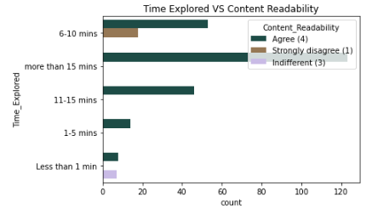
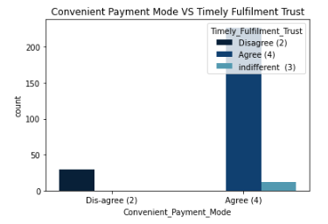
Observation:- @ Most of the customers agreed that the content on the website is easy to read and understand also they explored more than 15 mins before making the purchase decision and some of the customers strongly disagreed that the content is not good and they explored 6-10 mins before making the purchase decision. @ Most of the customers agree to the trust that the online retail stores will fulfil its part of the transaction at the time also most of them very happy with the convenient payment modes given by the websites. So, the retailers provide all type of payment methods then the customers can easily make the payment also it enhances the sales of the ecommerce sites.

Slide 17
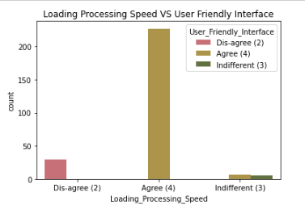
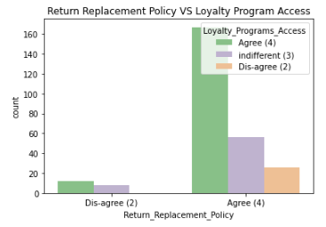
Observation:- # Most of the customers agreed with the user-friendly interface of the websites which can be easily loaded and processed also these websites' loading and processing capacity is very fast so that the customers like to shop in ecommerce websites. # Most of the customers agreed that return and replacement policy of the e-tailer is important for purchase decision also gaining access to loyalty programs is a benefit of shopping online. So, it is important for the online shopping websites to make easy return and replacement policy if they want to retain their customers. Also, by gaining access to loyalty programs, the customers get more and more rewards, increasing their engagement rate and thus bringing more profit to both company and customer.

Slide 18
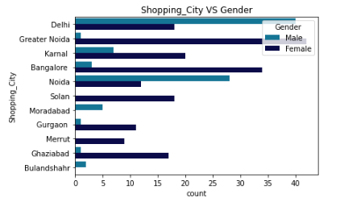
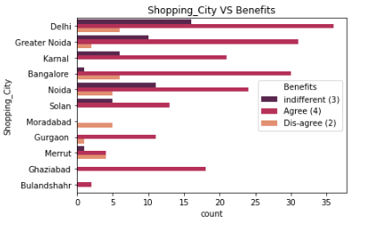
Observation:- # Most of the female are doing shopping than male those are mostly from Delhi NCR region. In Noida city very few males are doing online shopping than female. # From Delhi NCR region city felt that, they were more doing online shopping and getting more benefit than other city. These city customers took more benefit than other city.

Slide 19
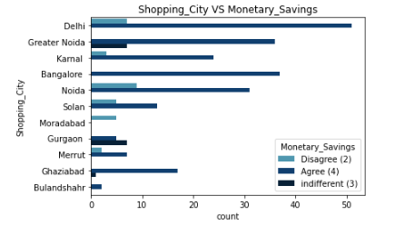
Observation:- From Delhi NCR region city customers felt that, they were more doing online shopping and saved more money than other city. Monetary saving from these city customers have more.

Slide 20
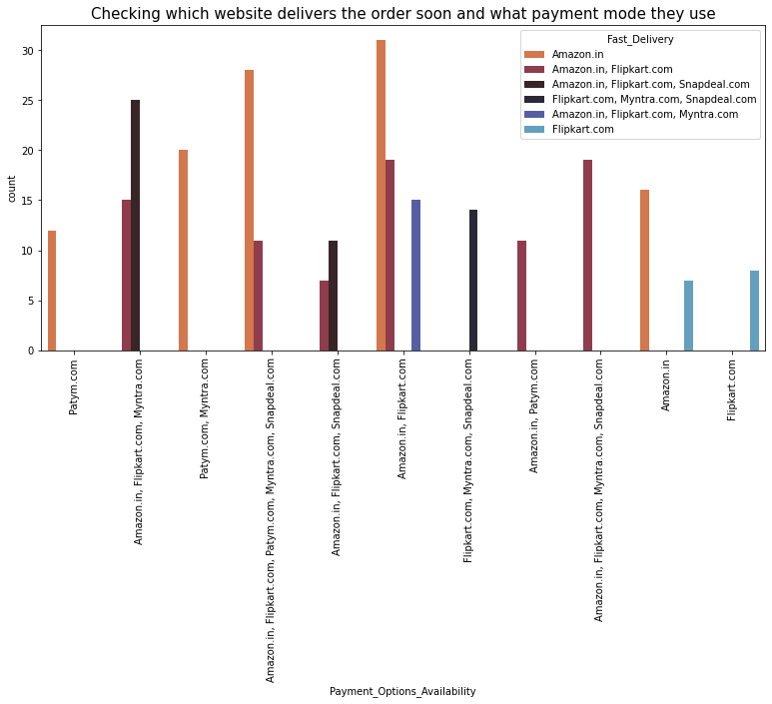
Observation:- Having different types of payment methods will helps the customers to pay the invoice easily using their choice of payment and if the websites have speedy delivery methods without delivery charge, then the customers like to buy the products in those websites.

Slide 21
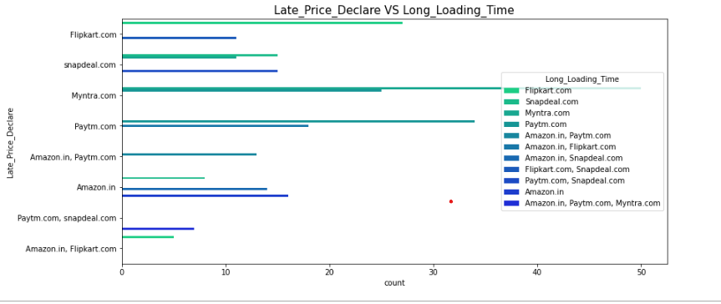
Observation:- Myntra takes time to load the page and it has late declaration of price in these days. Myntra declare the late price in order to clear the sales and they fix the price by comparing with other websites. These website has takes long loading time.

Slide 22
Assumption or recommendation to online sellers:- Data Privacy: - Data privacy is a main concern of online customers whose doing shopping. Therefore, online vendors can assure their consumers' by offering personal information privacy, protection policy improving their technological systems. Product Delivery: - Product delivery rate is high in few websites; they need to improved their rate of delivery because late delivery some of customer not willing to do Online shopping. Return and Replacement Policy: - In few websites have very poor return and replacement policy. In online shopping mixing or mismatch of the product is high. Due to this return and replacement rate is also high. So, company should have to take care of this issue for enhancing customer’s base. Payment Mode: - Payment mode and safety to transaction is necessary to attracting the customers. Sometime due to lack of internet speed some time delay in payment is happened so, company should provide more time cash on delivery option due to this customer may feel good.

Slide 23
CONCLUSIONS In this project, I have done some feature engineering by replacing the unwanted entries by suitable columns, found no null values, and renamed the columns by giving new names. Visualized the data using count plot, pie plot and distribution plot, also encoded the object data into numerical using label encoding method. Checked the statistical summary of the dataset and checked for skewness, outliers and correlation between the features. I found Amazon is the best online store where the customers trust on buying products and it has positive impact on the customers. Also, amazon and flip kart have increased customers’ expectations. So, they are the best online retailer who makes the loyal customers and satisfies the customers.

Slide 24

.

